Slide 1

Azure Bootcamp App Dev
Fredrik Tonn – fredrik.tonn@Microsoft.com - CSA

Slide 2
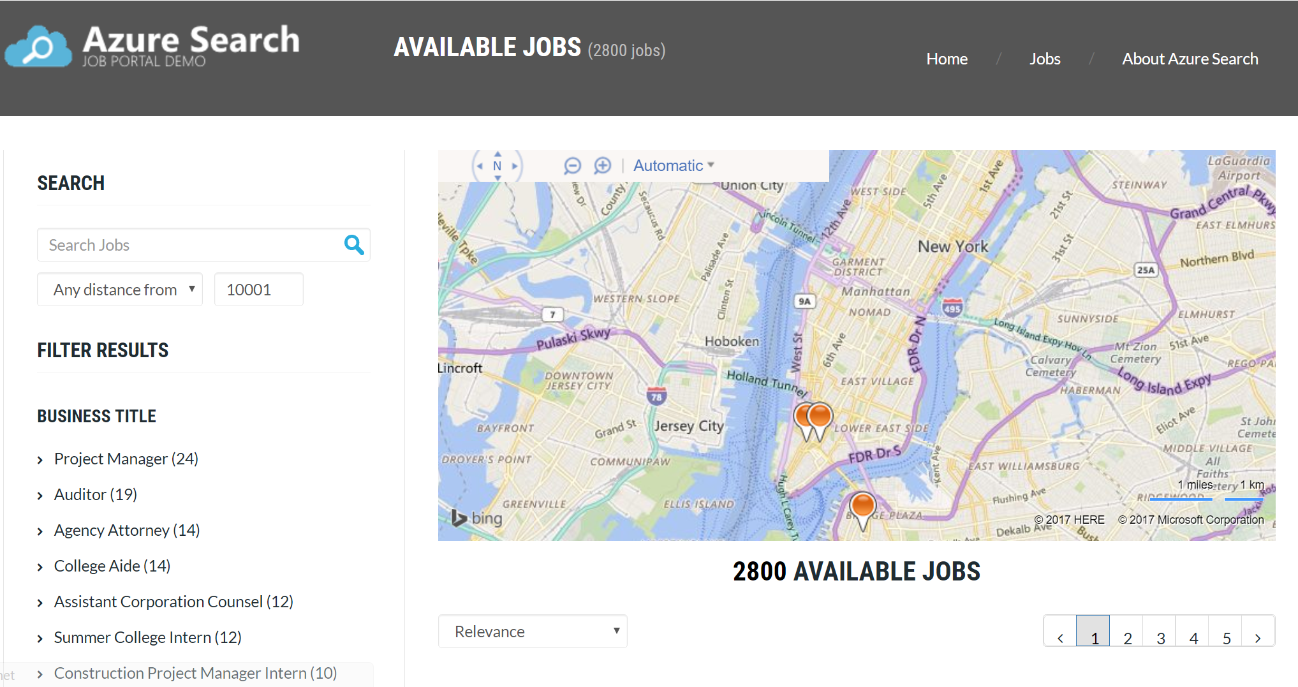

Slide 3
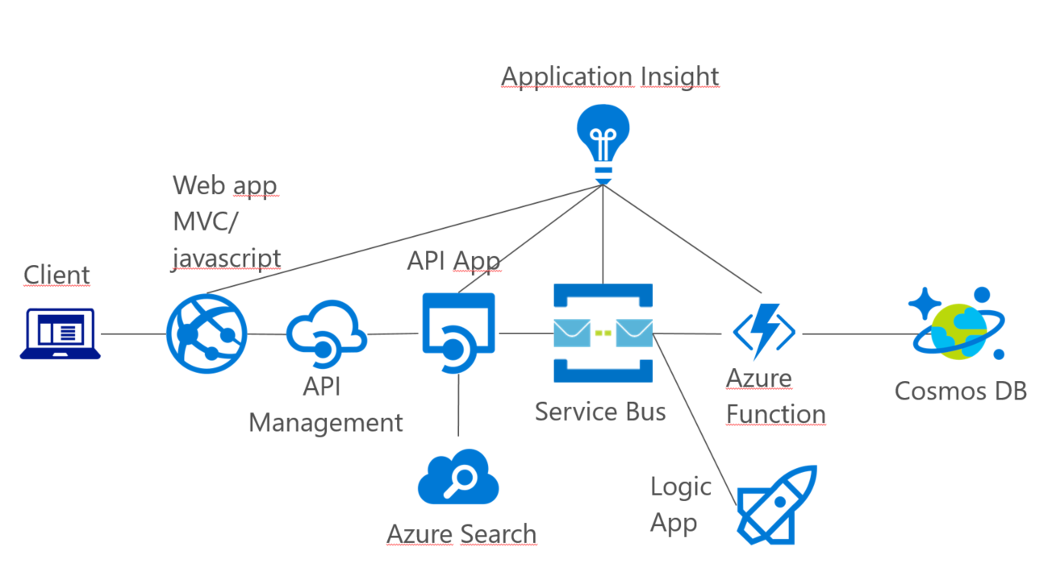

Slide 4
What is App Service?
Web service container in the cloud
Windows and Linux
.NET, Node.js, PHP, Java, Python, HTML
Serverless

Slide 5
What is API Management?
Govern all your API:s
One portal for all API:s
Ready snippets for iOS, Android, javascript, Ruby…
On board 3rd party safely
Spans all over the world in a click (premium)
Serverless

Slide 6
What is Service Bus?
Reliable information delivery
Queues
Topics
Subscriptions
Relay – WS*, SOAP, REST
Serverless

Slide 7
What is Azure Functions?
Small pieces of code
Good for ”glue”
Serverless

Slide 8
What is CosmosDB?
Globally distributed
Multi model
DocumentDB API
MongoDB API
Table API
Graph (Gremlin) API
Serverless

Slide 9
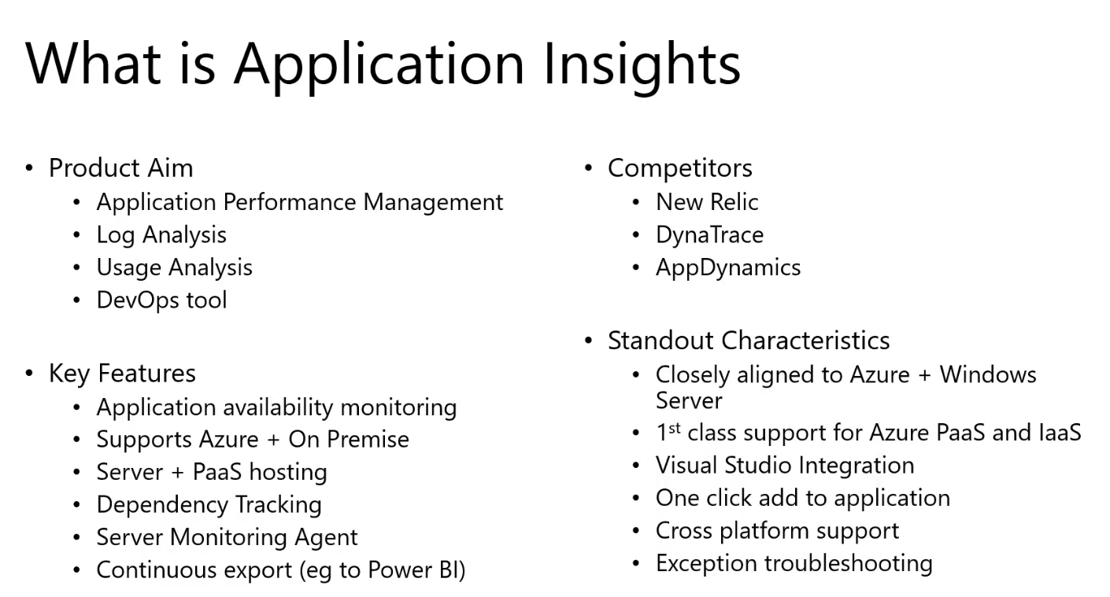
http://www.integrationusergroup.com/application-insights-integration-developers/

